Slide 1
Remotely Sensed Data
EMP 580
Fall 2015
Dr. Jim Graham
Materials from Sara Hanna

Slide 2
Remotely Sensed Data
Remotely Sensed data is:
  Acquired remotely from the observer
    This makes it different from field surveys
  Acquired by:
    Satellites
    Airplanes
    UAVs/UAS/Drones
    Automated Stations?

Slide 3
Active vs. Passive
“Sensors” can be active or passive
  Active sensors send out a signal and measure the returned signal:
    LiDAR
    Radar
  Passive sensors measure energy emitted by another source, usually the sun
    Most of the data we use (except DEMs) are from passive sensors so we’ll be talking about them from now on
For more information, see GSP 216

Slide 4
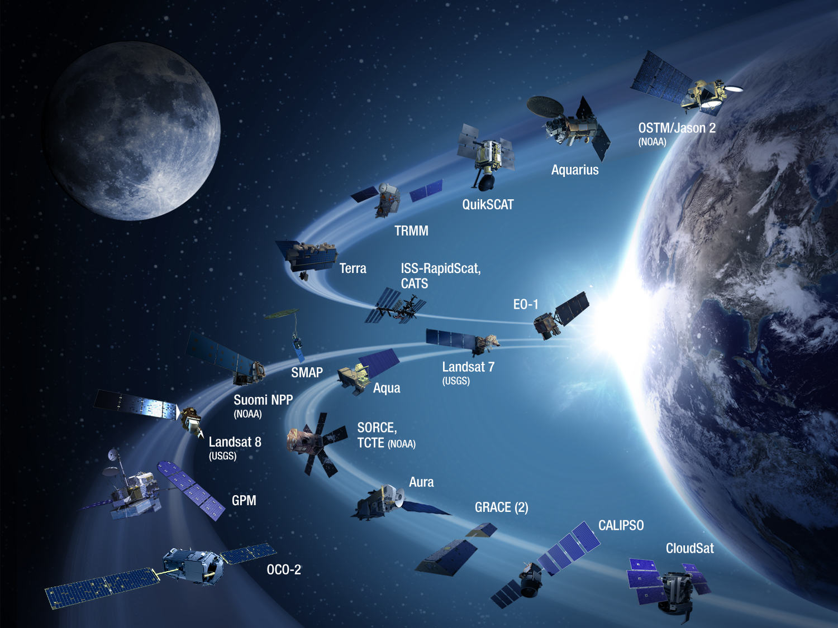
Earth Observing Satellites

Slide 5
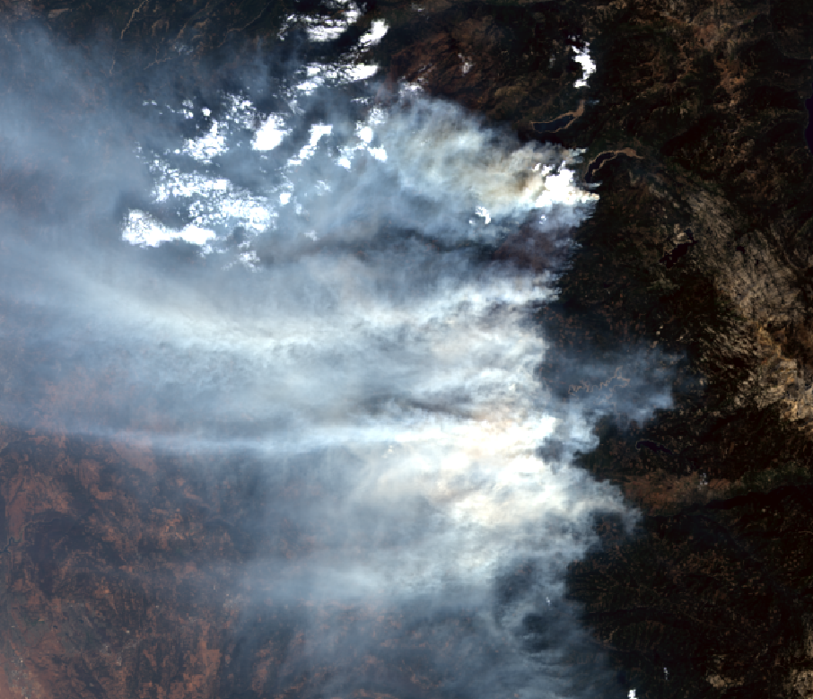
Landsat 8 – King Fire
True Color
Notes:
The King Fire was a wildfire that scorched over 97,000 acres of land in El Dorado County, California in the fall of 2014

Slide 6
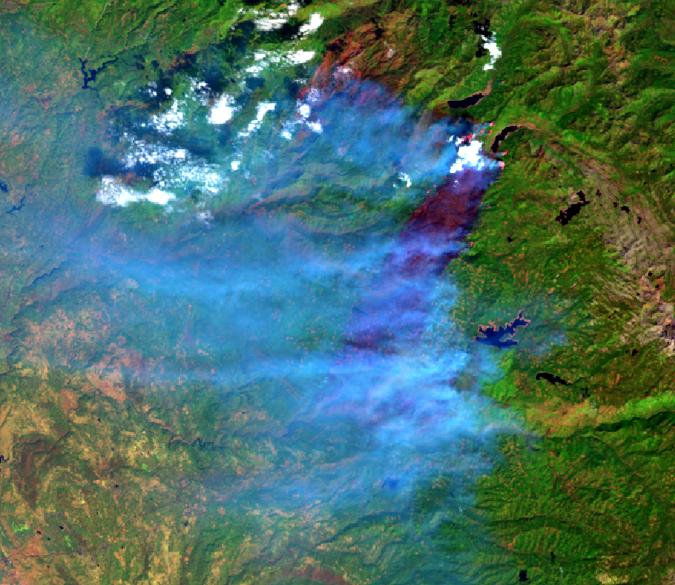
Landsat 8 - King Fire
False Color (Red – Shortwave Infrared, Green – NIR, Blue – Visible)

Slide 7
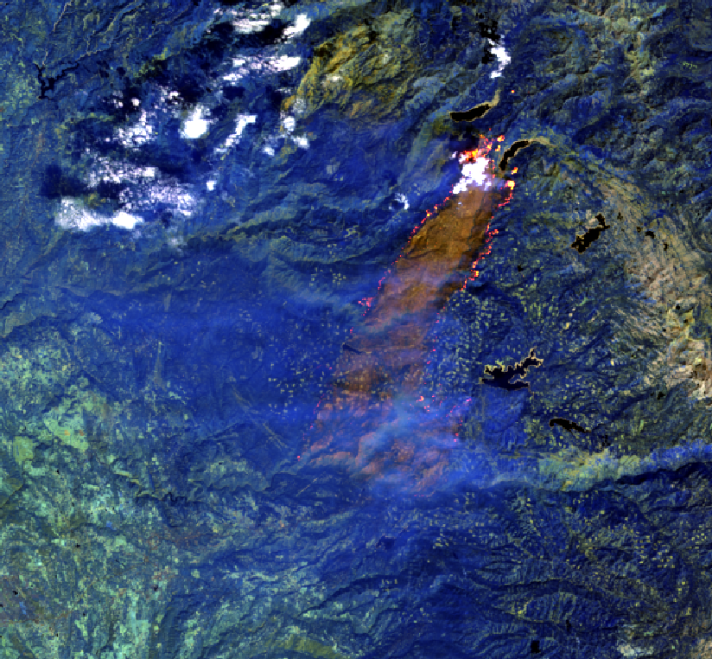
Landsat 8 - King Fire
False Color (Red – Shortwave Infrared, Green – Shortwave Infrared, Blue – NIR)

Slide 8
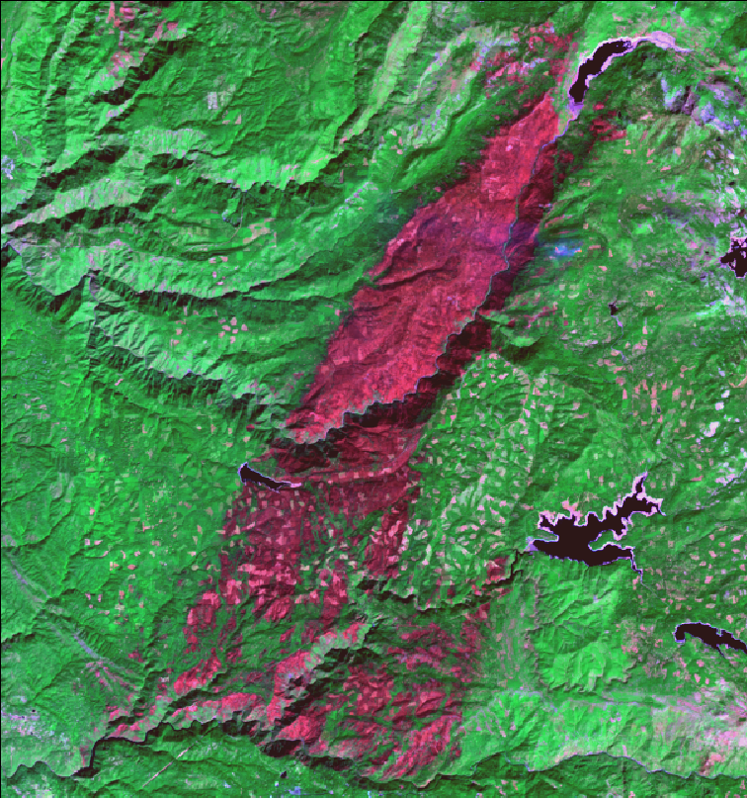
Landsat 8 – King Fire
October 5, 2014

Slide 9
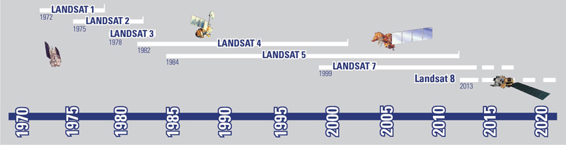
Landsat Timeline

Slide 10
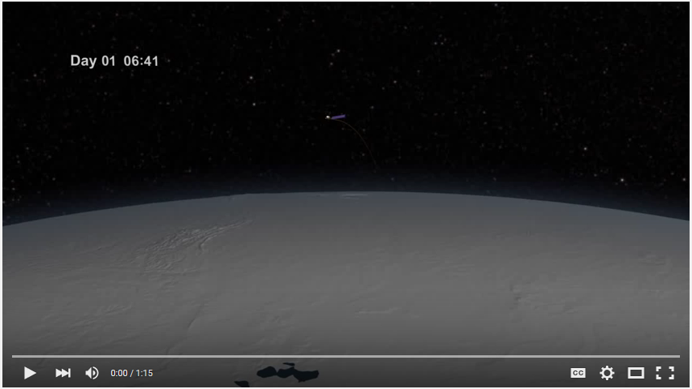
Landsat Orbit
http://www.youtube.com/watch?v=P-lbujsVa2M

Slide 11
Landsat
The Landsat satellites have carried six different sensor types
Return Beam Vidicon (RBV)
Multispectral Scanner (MSS)
Thematic Mapper (TM)
Enhanced Thematic Mapper (ETM)
Enhanced Thematic Mapper Plus (ETM+)
Operational Land Imager (OLI) and Thermal Infrared Sensor (TIRS)

Slide 12
Enhanced Thematic Mapper Plus (ETM+)
Enhanced Thematic Mapper Plus (ETM+) | Landsat 7 | Wavelength (micrometers) | Resolution (meters)
 | Band 1 | 0.45-0.52 | 30
 | Band 2 | 0.52-0.60 | 30
 | Band 3 | 0.63-0.69 | 30
 | Band 4 | 0.77-0.90 | 30
 | Band 5 | 1.55-1.75 | 30
 | Band 6 | 10.40-12.50 | 60
 | Band 7 | 2.09-2.35 | 30
 | Band 8 | .52-.90 | 15

Slide 13
Where to obtain data?
USGS EarthExplorer
  http://earthexplorer.usgs.gov/
USGS Global Visualization Viewer - GLOVIS
  http://glovis.usgs.gov/
USDA Geospatial Data Gateway
  http://datagateway.nrcs.usda.gov/

Slide 14
What data products are available?
Landsat Archive
MODIS
Aerial photos
  Historical
  NHAP/NAAP/NAIP
Digital Elevation Models
Climate Data
Watershed
Land Use/ Land Cover
Soils

Slide 15
File Sizes
  MODIS Image -11,127,225 pixels (7 bands, 500m resolution)
  Landsat Panchromatic - 234,404,221 pixels (1 band,15 m resolution)
  Landsat Multispectral - 58,532,901 pixels (7 bands, 30m resolution)
  NAIP Image - 261,532,200 pixels (4 bands, 1 m resolution)

Slide 16
What format ?
Most data is downloaded in a compressed format
Large file sizes
Level 1 Data
  Corrected for radiometric and geometric accuracy
  GeoTIFF data format
  Separate file for each band

Slide 17
Commercial
SPOT – 1986-2014 (1.5 – 20m)
IKONOS – 1999 (1 -4 m)
  Quickbird – 2001 (0.60 - 2.4 m)
  World-View-2 – 2009 (0.46 – 1.84m)
  WorldView-3 – 2014 (0.31 – 3.7 m)
  Disaster Monitoring Constellation (DMC) 2002-Present
    Five satellites, 30-40 m in 3-4 bands

Slide 18
Electromagnetic Radiation
Most remotely sensed data is derived from Electromagnetic Radiation (EMR). This includes:
  Visible light
  Infrared light (heat)
  X-Rays
  Radar
  Etc.
To use RS data we need to review some information on EM

